Slide 1
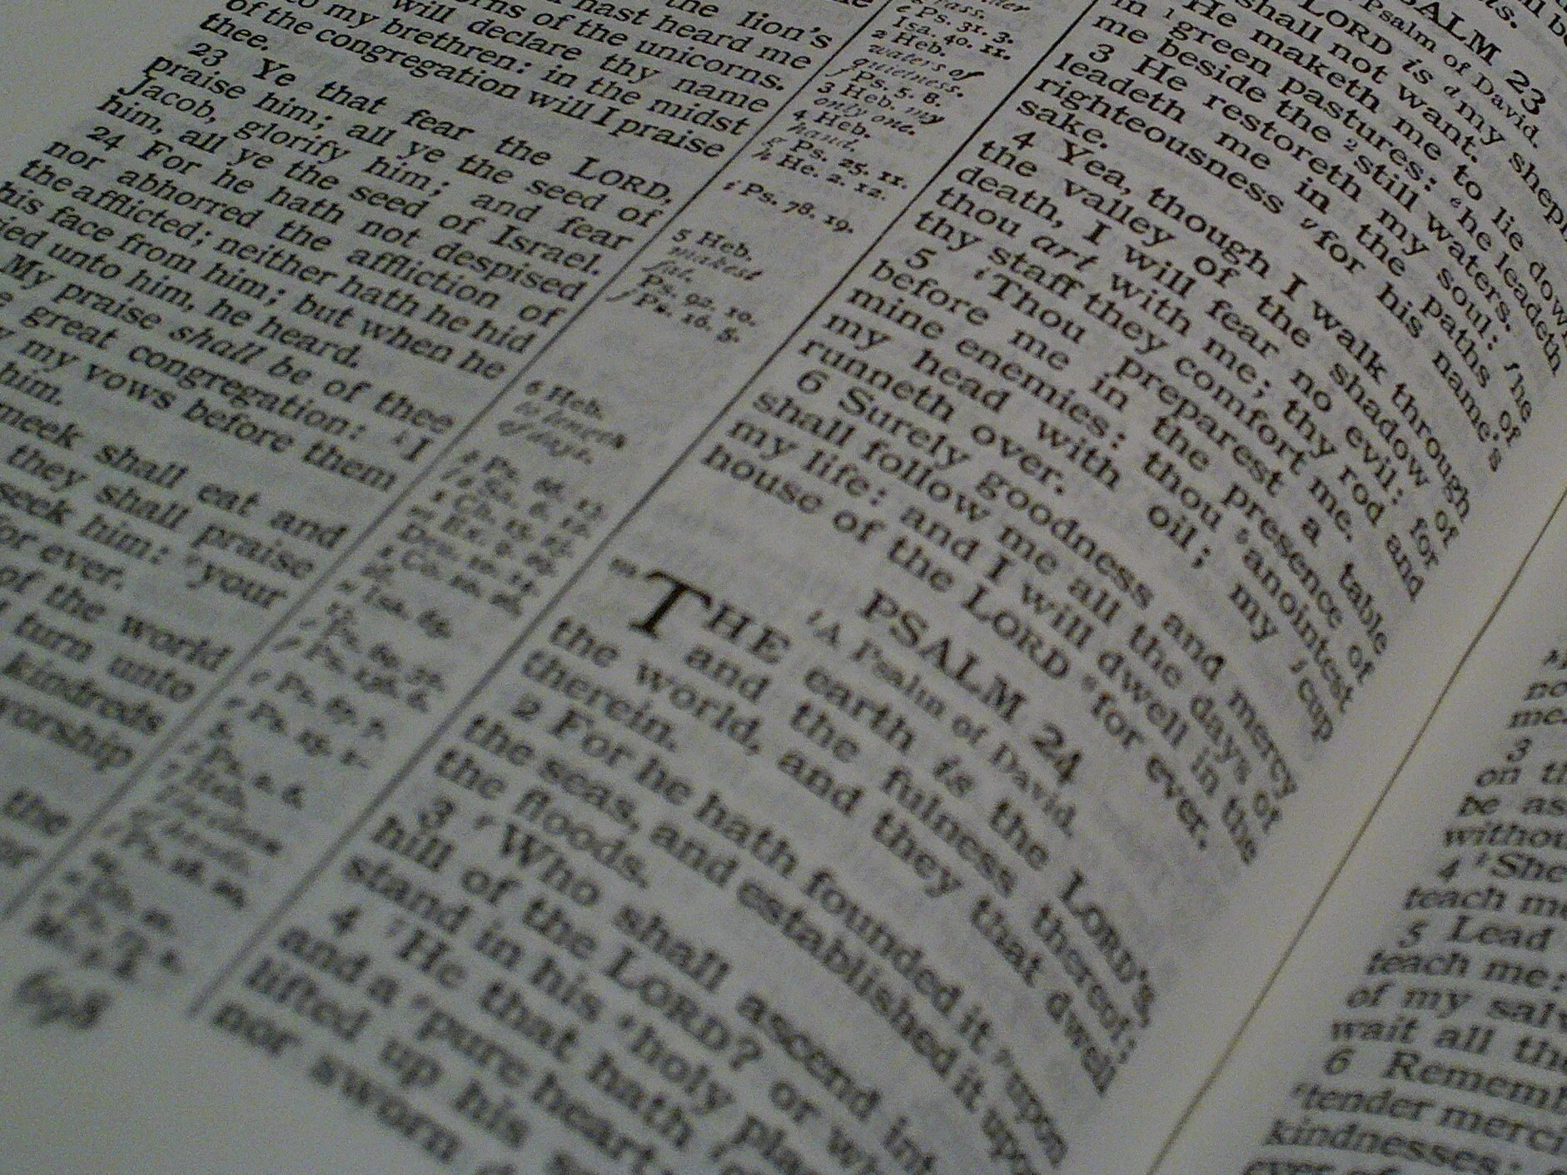

Facts for Faithful Followers
Basic truths (‘doctrines’) that every Christian should know!

Slide 2


Last Week’s Memory
Verse
Is your memory cloudy?
“He who began a good work in you will carry it on to completion until the day of Christ Jesus.”
Philippians 1:6

Slide 3
Facts for Faithful Followers
The Church

Slide 4
This Week’s Memory
Verse
“God placed all things under his feet and appointed him to be head over everything for the church, which is his body, the fullness of him who fills everything in every way.”
Ephesians 1:22-23

Slide 5
What does the word “church” tell us?
About that time there arose a great disturbance about the Way. A silversmith named Demetrius … brought in a lot of business for the craftsmen there. He called them together, along with the workers in related trades
Comes from Greek:
A group of people called out of a bigger community to do something
An “assembly”
See the non-religious example in Acts –
Acts 19:32 and look back to v25

Slide 6
What is the church?
It is:
people called out of the world to Christ –
Romans 1:5-6
Christ's body – Ephesians 1:22-23
So the church is:
Christ's embodiment on Earth
NOT a club
a living organism called by God to be Christ-on-Earth as its parts relate together
God placed all things under his feet and appointed him to be head over everything for the church, which is his body, the fullness of him who fills everything in every way
(writing to church in Rome) You also are among those Gentiles who are called to belong to Jesus Christ

Slide 7
Who is the church?
God has placed in the church first of all apostles
the church throughout Judea, Galilee and Samaria enjoyed a time of peace
The Bible uses the term in several ways:
The invisible church – 2 Timothy 2:19
The visible church – 2 Corinthians 11:14-15
The local church – Romans 16:5
The city-wide or regional church – Acts 9:31
The worldwide church – Ephesians 5:25
Satan himself masquerades as an angel of light. It is not surprising, then, if his servants also masquerade as servants of righteousness.
The Lord knows those who are his
Greet also the church that meets at their house

Slide 8
The characteristics of the church
Just as a body, though one, has many parts, but all its many parts form one body, so it is with Christ
Do not rebuke an older man harshly, but exhort him as if he were your father. Treat younger men as brothers, older women as mothers, and younger women as sisters
People loved by Christ even to the extent of him sacrificing himself for it - Ephesians 5:25
It is being built by Christ - Matthew 16:18
Christ is perfecting the church as his bride - Revelation 21:9, Ephesians 5:28-32
It is relational - between members - 1 Timothy 5:1-2 & between members & Christ - Ephesians 5:28-32
Each member has purpose, value, a Christ-given role -1 Corinthians 12:12-on. Christ is the church’s head, ‘glue’ and equipper - Ephesians 1:22-23 & 4:15-16
[The church is] the mature body of him who is the head, that is, Christ. From him the whole body, joined and held together by every supporting ligament, grows and builds itself up in love, as each part does its work
God placed all things under his feet and appointed him to be head over everything for the church, which is his body, the fullness of him
I will build my church, and the gates of Hades will not overcome it
Husbands, love your wives, just as Christ loved the church and gave himself up for her
The bride, the wife of the Lamb.

Slide 9
The purpose of the church
[Christ will make the church] holy, cleansing her by the washing with water through the word, and to present her to himself as a radiant church, without stain or wrinkle or any other blemish, but holy and blameless.
[The apostles] asked that we remember the poor.
Let us do good to all people, especially to those who belong to the family of believers.
Mutual encouragement – Hebrews 10:24-25
Nurturing members – Col. 1:28, Eph. 4:12-13
Declaring the good news & truth – Eph. 6:15
Praising God together – Colossians 3:16
Managing Baptism & Lord’s Supper
Reflecting Christ – Ephesians 5:26-27
To care for others – Galatians 2:10, 6:10
To do these things together – John 17:21
that all of them may be one
Admonishing and teaching everyone with all wisdom, so that we may present everyone fully mature in Christ
Equip his people for works of service, so that the body of Christ may be built up until we all reach unity in the faith and in the knowledge of the Son of God and become mature, attaining to the whole measure of the fullness of Christ
Let us consider how we may spur one another on toward love and good deeds … encouraging one another
Teach and admonish one another with all wisdom through psalms, hymns, and songs from the Spirit, singing to God with gratitude in your hearts
With your feet fitted with the readiness that comes from the gospel of peace

Slide 10

Susie & Norm’s Schools (!)

Slide 11

Susie & Norm’s Schools (!)

Slide 12
over to Abi …..

Slide 13
Oh how good it is when the family of God dwells together in spirit in love and unity.
Where the bonds of peace, of acceptance and love are the fruits of His presence here among us.

Slide 14
So with one voice we’ll sing to the Lord, and with one heart we’ll live out His word.
Till the whole earth sees the Redeemer has come – for He dwells in the presence of His people.

Slide 15
Oh how good it is on this journey we share to rejoice with the happy and weep with those who mourn.
For the weak find strength, the afflicted find grace. when we offer the blessing of belonging.

Slide 16
So with one voice we’ll sing to the Lord, and with one heart we’ll live out His word.
Till the whole earth sees the Redeemer has come – for He dwells in the presence of His people.

Slide 17
Oh how good it is to embrace His command – to prefer one another, forgive as He forgives.
When we live as one we all share in the love of the Son with the Father and the Spirit.

Slide 18
So with one voice we’ll sing to the Lord, and with one heart we’ll live out His word.
Till the whole earth sees the Redeemer has come – for He dwells in the presence of His people.
Keith Getty, Kristyn Getty, Ross Holmes, and Stuart Townend
© 2012 Gettymusic and Parakeet Boots Music and Townend Music CCL License No. 291588

Slide 19

Question Time !
Why are there several churches in Stapleford?
In what ways is SBC a church as Christ wants it to be, and how is it not?
If someone insists that they can be a Christian without going to church, what would you say?
What would you do / say to someone who says “I don’t get anything out of church, I’m leaving this one to go elsewhere”?
The church is Christ’s body. How do you feel you fit into it?

Slide 20

Prayer Time !
Praise God that He has continued His work on earth and miraculously chooses to work through us.
Consider your attitude towards SBC - what praise, repentance, thanksgiving, intercession can you give?
Pray for the worldwide church and our role supporting others.
Pray that our church (and our own service within it) will honour God and continue to fulfil His purposes on earth

Slide 21

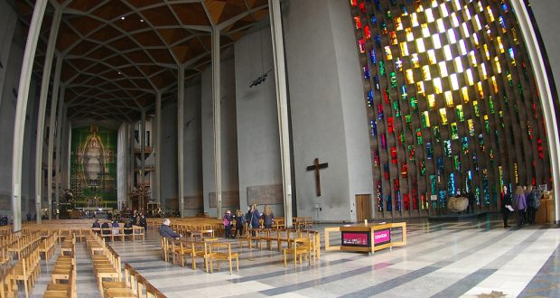
Take Home!
The Coventry Cathedral Welcome Card!

Slide 22
Back to Andrew …..

Slide 23
This Week’s Memory
Verse
“God placed all things under his feet and appointed him to be head over everything for the church, which is his body, the fullness of him who fills everything in every way.”
Ephesians 1:22-23

Slide 24
Church of God, elect and glorious,
holy nation, chosen race;
called as God’s own special people,
royal priests and heirs of grace;
know the purpose of your calling,
show to all his mighty deeds;
tell of love that know no limits,
grace that meets all human needs.

Slide 25
God has called you out of darkness,
into his most marv’lous light;
brought his truth to life within you,
turned your blindness into sight.
Let your light so shine around you
that God’s name is glorified;
and all find fresh hope and purpose
in Christ Jesus crucified.

Slide 26
Once you were an alien people,
strangers to God’s heart of love;
but he brought you home in mercy,
citizens of heav’n above.
Let his love flow out to others,
let them feel a Father’s care;
that they too may know his welcome
and his countless blessings share.

Slide 27
Church of God, elect and holy,
be the people he intends;
strong in faith and swift to answer
each command your master sends;
royal priests, fulfill your calling
through your sacrifice and prayer;
give your lives in joyful service—
sing his praise, his love declare.
James Seward, 1915-1983
© Jubilate Hymns, CCL Licence number: 291588

Slide 28
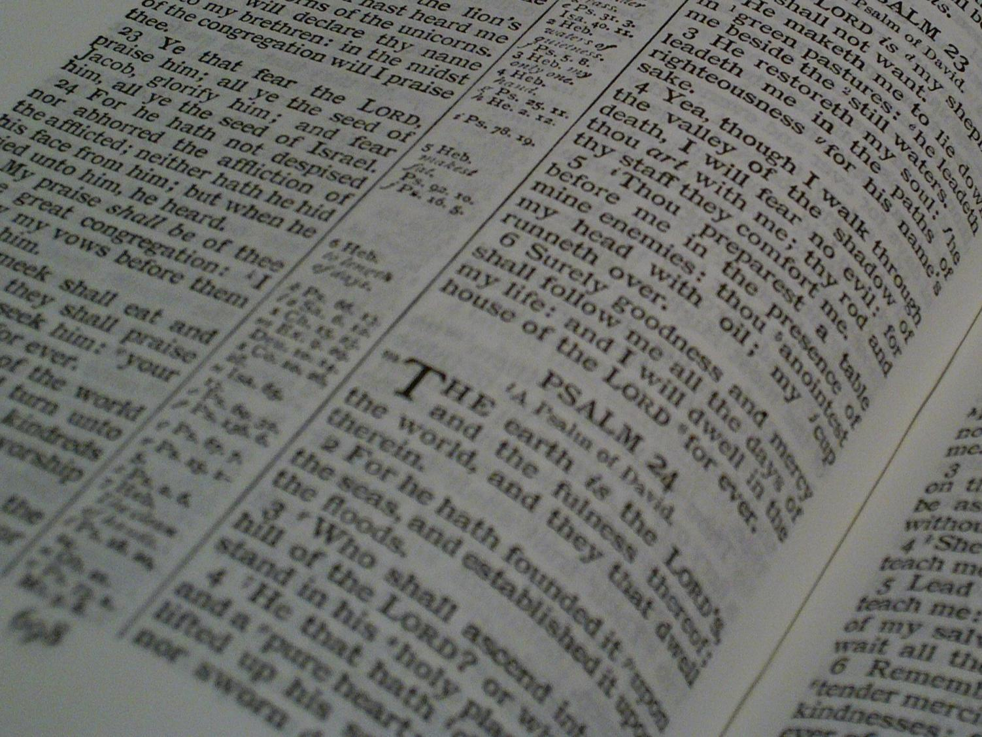
Facts for Faithful Followers
Until next week …
… Death & Resurrection

